Slide 1
HDL Part I
陳培殷
國立成功大學 資訊工程系

Slide 2
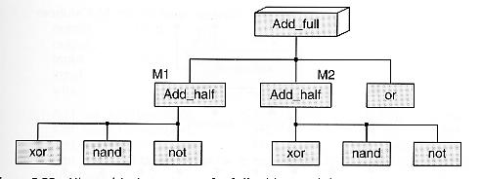
Top-Down Design Flow
Full-Adder
Design
Sub
block
Sub
block
Sub
block
Sub
block
Basic
Element
Basic
Element
Basic
Element
Basic
Element
Basic
Element
Basic
Element
Basic
Element
Basic
Element

Slide 3
Design Entry for VLSI System
Choose the design entry method:
Schematic
Gate level design
Intuitive & easy to debug
HDL (Hardware Description Language)
Descriptive & portable
Easy to modify
Mixed HDL & Schematic
always @(IN)
begin
OUT = (IN[0] | IN[1]) & (IN[2] | IN[3]);
end

Slide 4
Hardware Description Language (HDL)
Hardware description language allows you to describe circuit at different levels of abstractions, and allows you to mix any level of abstraction in the design
Two of the most popular HDLs
-- Verilog -- VHDL
HDLs can be used for both the cell-based synthesis and FPGA/CPLD implementation
Only Verilog is introduced here

Slide 5
Why Verilog?
Verilog History
Verilog was written by gateway design automation in
the early 1980
2. Cadence acquired gateway in 1990
3. Cadence released Verilog to the public domain in 1991
4. In 1995, the language was ratified as IEEE standard 1364
Why Verilog ?
1. Choice of many design teams
2. Most of us are familiar with C- like syntax/semantics

Slide 6
Verilog Features
Features:
Procedural constructs for conditional, if-else, case and looping operations
Arithmetic, logical, bit-wise, and reduction operations for expression
Timing control
- Identifier -Keyword -Verilog Module -Numbers
- Port Mapping - Operator - Comments
Basics of Verilog Language:

Slide 7
Identifier
Identifiers are names given to Verilog objects
Names of modules, ports and instances are all identifiers
First character must use a letter, and other character can use letter, number or “_”
Upper case and lower case letters are different
How to determine a suitable name ???

Slide 8
Keywords (1/2)
Predefined identifiers to define the language constructs
All keywords are defined in lower case
Cannot be used as identifiers
Examples: module, initial, assign, always,
endmodule, …

Slide 9
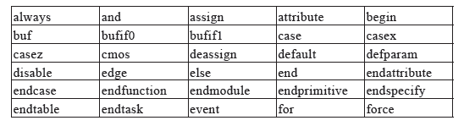
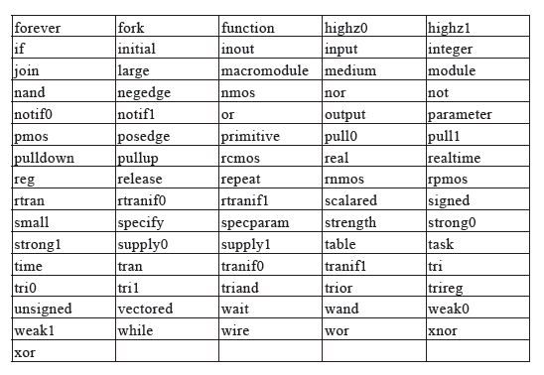
Keywords (2/2)
All keywords
are defined in
lower case.

Slide 10
Data type - net (wire)

Slide 11
Data type - reg
A reg data type represents a variable in Verilog
Type ”reg” variable stores values, but not necessarily a FF (register)
Are only assigned in an ”always” block task or function
If a reg data type is assigned a value in an always block that has a clock edge expression, a flip-flop is inferred

Slide 12
Verilog Module (1/3)
Response
Generation
Stimulus
and
Control
Verilog
Module
Waveform,
test patterns
Waveform,
text reports
Verification

Slide 13
Verilog Module (2/3)
module module_name (port_name);
port declaration
data type declaration
module functionality or structure
endmodule
(1)
module Add_half(sum, c_out, a, b);
input a, b;
output sum, c_out;
wire c_out_bar;
xor (sum, a, b);
nand (c_out_bar, a, b);
not (c_out, c_out_bar);
endmodule
(2)
(1)
(3)
(2)
(3)
c_out_bar
c_out

Slide 14
Verilog Module (3/3)
Verilog Module: basic building block
module DFF
--------------------
--------------------
-------------------
-
-
-
------------------
------------------
endmodule
module ALU
--------------------
--------------------
-------------------
-
-
-
------------------
------------------
endmodule
module MUX
--------------------
--------------------
-------------------
-
-
-
------------------
------------------
endmodule

